Slide 1
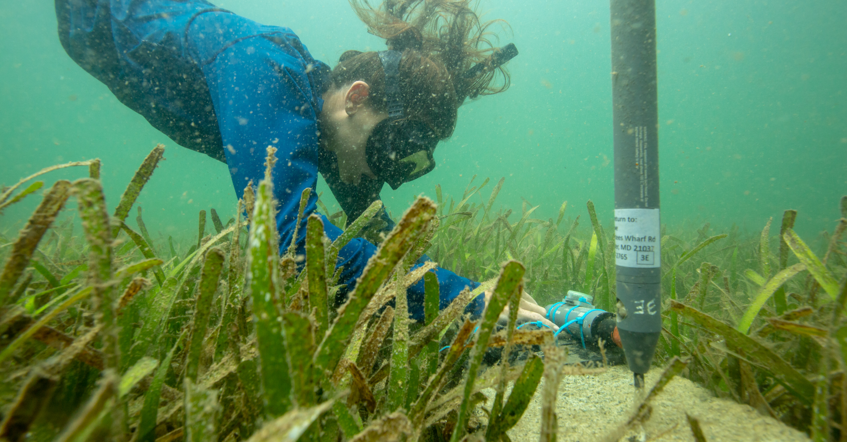

Take a dip in the SI Research Data Lake Michael Lonneman (SERC-MarineGEO) & Adam Soroka (Research Computing)

Slide 2
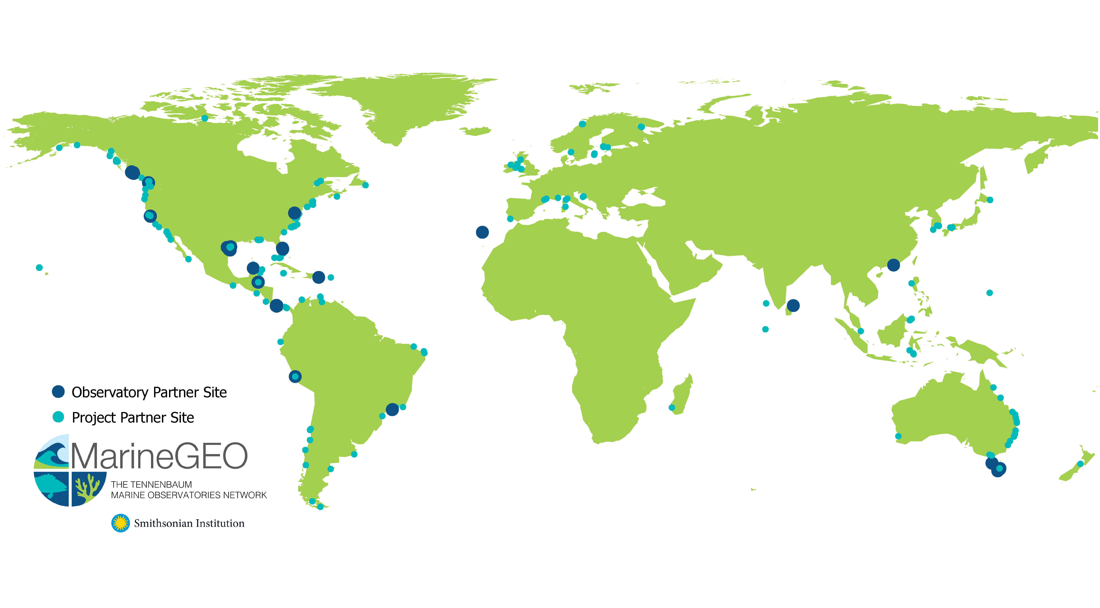
Global team science to sustain marine ecosystems on the edge
34 countries | 56 coastal ecoregions | 6 continents

Slide 3
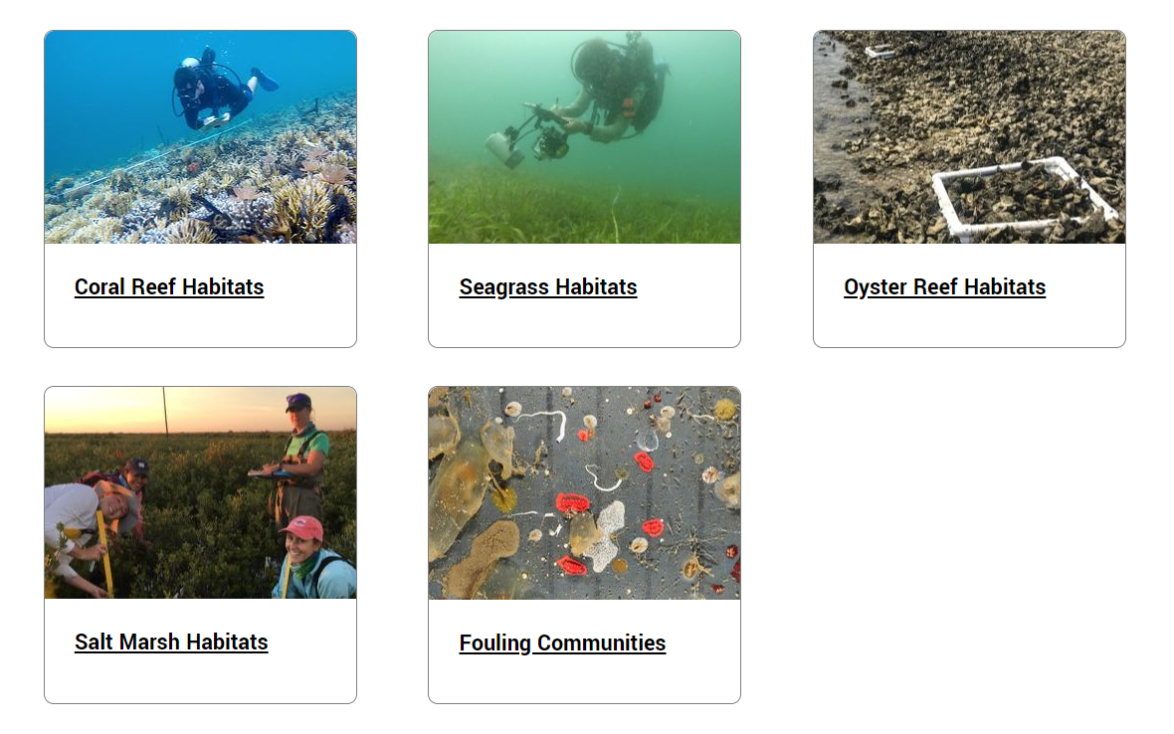
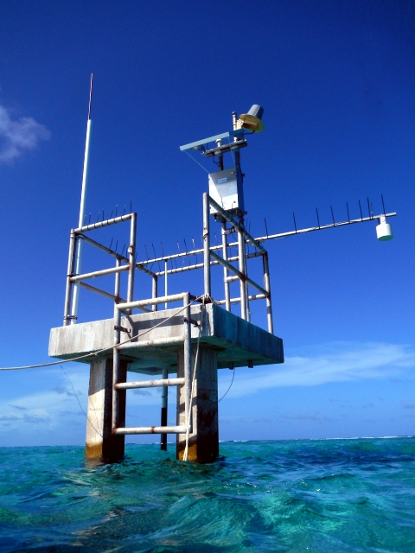
Environment

Slide 4
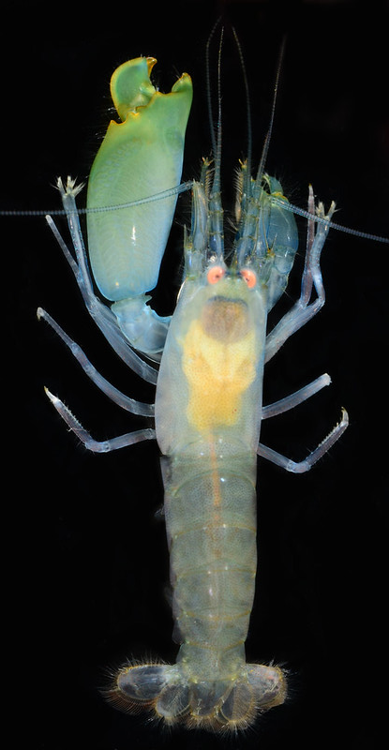
MarineGEO Data Management Challenges
Managing high volumes of data as flat files on personal machines did not scale well
Wanted to avoid a rigid, relational database approach - data model needed to be flexible and evolve
Can be difficult to make data available within and outside SI
Needed a bottom-up approach to data management that is transparent and accessible to researchers using technologies MarineGEO team uses - R
Needs to reduce barriers for data analysis and data integration
Photo credit Smithsonian
Marine Station

Slide 5
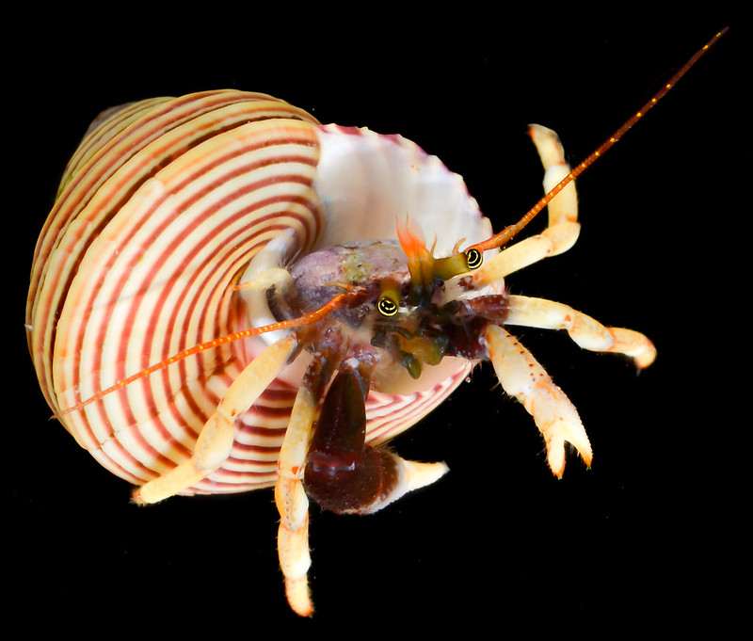
Friendly SI Admins of Useful Services
Adam Soroka (SI Research Data lake)
Luis Villanueva (R-Shiny)
Keri Thompson (figshare)
Photographer: Gustav Paulay, Florida Museum of Natural History

Slide 6


What is a Data Lake? Shiny?
A data lake is a computer cluster that can function as both a data warehouse and a high compute resource
R Shiny is an R package for interactive web applications

Slide 7

Level 1
Level 2
Level 3
Apache Hadoop Cluster
Data Inputs
Convert to flat file CSV
Process data for publishing
Apply calibration factors based on technician mark-up
Input Data
R Shiny (Internal) CPOP App
R Shiny (Internal) Annotation App
R Shiny (external)
Public App
Visualize
Technician mark-up QC
Query & Transform
Visualize
Download

Slide 8
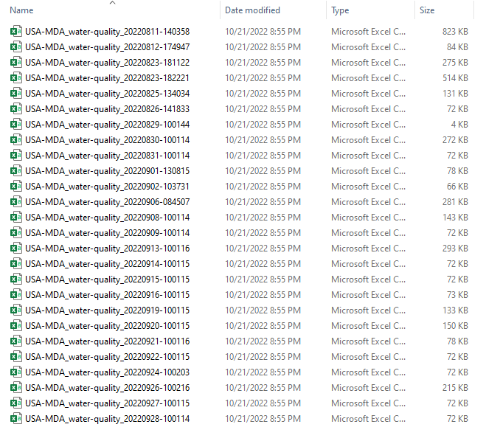
Data in the Lake
Directory of flat files but can access as if it’s a database using Hive tables
Facilitates data access! Ability to write queries or just copy some files.

Slide 9
Sondes
Level 1
Level 2
Level 3
Apache Hadoop Cluster
Loggernet
Site A
Korexo
Manual
Loggernet
Site B
Korexo
Manual
Loggernet
Site C
Korexo
Manual

Slide 10

Sondes
Level 1
Level 2
Level 3
Apache Hadoop Cluster
Loggernet
Site A
Korexo
Manual
Loggernet
Site B
Korexo
Manual
Loggernet
Site C
Korexo
Manual

Slide 11
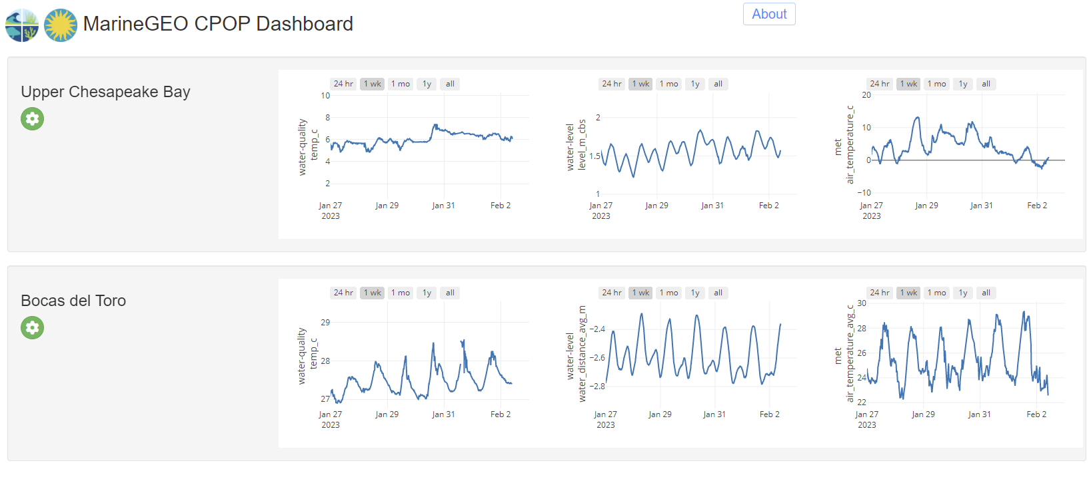

Slide 12
Chemical and Physical Observation Program (CPOP) Data Model
Level 1
Level 2
Level 3
Apache Hadoop Cluster
Data Inputs
Convert to flat file CSV
Process data for publishing
Apply calibration factors based on technician mark-up
Loggernet
R Shiny (Internal) CPOP App
R Shiny (Internal) Annotation App
R Shiny (external)
Public App
Visualize
Technician mark-up QC
Query & Transform
Visualize
Download

Slide 13
Chemical and Physical Observation Program (CPOP) Data Model
Level 1
Level 2
Level 3
Apache Hadoop Cluster
Data Inputs
Convert to flat file CSV
Process data for publishing
Apply calibration factors based on technician mark-up
Loggernet
R Shiny (Internal) CPOP App
R Shiny (Internal) Annotation App
R Shiny (external)
Public App
Visualize
Technician mark-up QC
Query & Transform
Visualize
Download
Notes:
We have scripts to utilize the figshare API to publish data.
Multistage aggregation with all intermediate products (monthly, etc.) persistently available for reuse Complete flexibility to access data promotes collaboration and data integration
The Shiny apps are not the only way to access data: anyone at SI can use a database connection to access this data. Can take MarineGEO CPOP data and combine with own data for novel analyses. For non-tabular data, access via file system or Spark API (for ML or other HPC)
Data managers can still restrict access to some or all datasets if necessary.

Slide 14
Interacting Project Model
SERC- Historical Data
SERC-Biodiversitree
SI-MarineGEO Data
Data workflow in shared data lake
SERC- GCREW Experiments
ModEX
1-stop for querying combined analysis with record of analysis
SERC-DOE projects
SERC-Public meteorology
Repositories
FIGSHARE
ESSDIVE
models,
machine learning, research analysis, postdoc playground
SERC- WEIR system
Publications
Reviews and Meta-Analyses

Slide 15
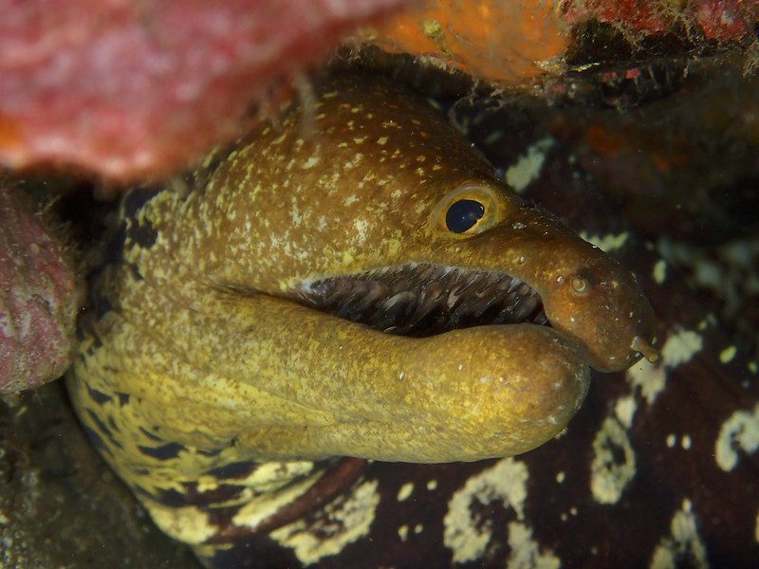
Acknowledgements
Adam Soroka (SI Research Data lake)
Luis Villanueva (R-Shiny)
Keri Thompson (figshare)
Roy Rich (SERC)
Selina Cheng (SERC)
Photograher: João Monteiro MARE-Madeira/ARDITI

